Slide 1

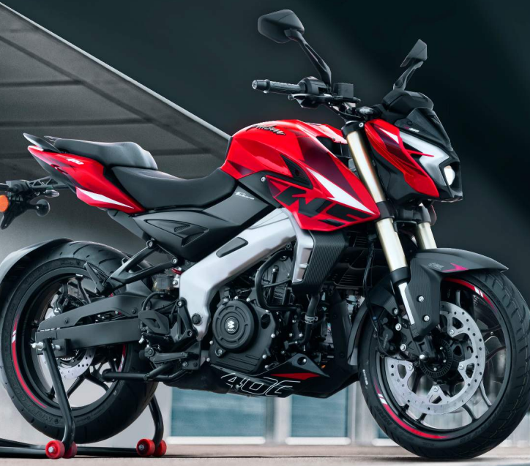
VALUATION OF
BAJAJ AUTO
SECTION A | GROUP 10
AISHWARYA VERMA – MBA202325-013
ANANYAA SAIKIA – MBA202325-031
CHAITANYA VLVS – MBA202325-060
CHANDRA VIKAS – MBA202325-062
CHANDRA MOULIKA - MBA202325-063
CHITRALEKHA.CH - MBA202325-067
DEEPTI BEHERA – MBA202325-070

Slide 2

INTRODUCTION
Founded by Jamanalal Bajaj in 1945
Two-wheeler and Three-wheeler manufacturing company
Headquartered in Pune, India.
Manufacturing Plants are located in Maharashtra and Uttarakhand
Exports to more than 70 countries.
Chairman: Niraj Bajaj
MD and CEO: Rajiv Bajaj
Employees: 10000+

Slide 3
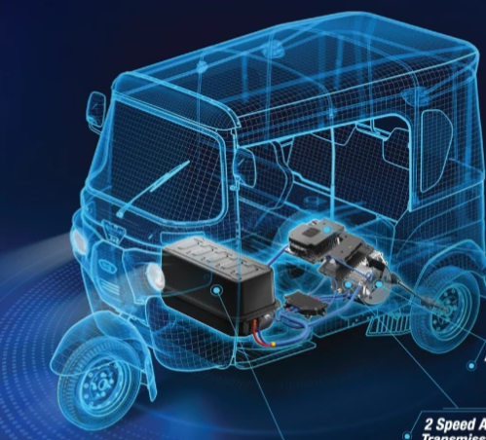
INDUSTRY OVERVIEW
Bajaj Auto is a prominent player in the global automotive industry, particularly known for its motorcycles, scooters, and three-wheelers.
It is one of the top three two-wheeler manufacturers in India, competing with Hero MotoCorp and Honda. It has a significant share in the motorcycle segment and a growing presence in the scooter market.
It has a strong export presence and is one of India’s largest automotive exporters. It has expanded its footprint in markets across Africa, Latin America, and Southeast Asia.
It focuses on innovation and technology, introducing new models and features to stay competitive and it is exploring electric mobility with products like the Bajaj Chetak Electric.
Revenue: Approximately 446 billion in 2024.
Net Profit: Around ₹5,000–7,000 crore annually.
EBITDA Margin: It is in the range of 15-20%, reflecting healthy operational performance.
It has historically been a strong performer in the Indian stock market with a market capitalization often exceeding ₹1 lakh crore.

Slide 4
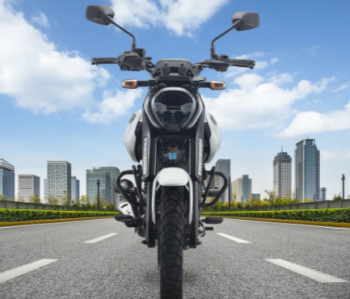
BAJAJ AUTO
Bajaj Auto is a major player in the two-wheeler and three-wheeler segments, both domestically and internationally. It has a well-established brand with strong market recognition.
The company’s investments in technology and new product development, including electric vehicles, provide a rich area for analysis on how innovation impacts valuation.
Its focus on sustainability and eco-friendly technologies, including its product lines into electric vehicles, provides a relevant context for examining how corporate responsibility impacts valuation.
The company's CSR initiatives and their impact on brand value and stakeholder relationships can be valuable areas of exploration.
The automotive industry is undergoing significant changes, making it a dynamic and relevant sector to study for future business leaders.

Slide 5
Forecasting of Annual Statements-Assumptions
Sales growth rate = past 5 years avg at 8.13%
Operating Profit margin = past 10 years avg at 18.51%
Depreciation Rate : Net Block(Net PPE)/Depreciation expense in that year
Interest Exp: Based on historical (int exp / avg total debt)
Historical Tax Rate = tax paid / PBT
Borrowings, other liabilities, capital WIP, other assets also calculated based on relevant historical ratios assuming them to be constant.

Slide 6
CAPITAL EXPENDITURE
Change in Net PPE from last year = Capex for this Year
Average capex of 2022,23,24= remain constant from 2026 to 2029
Capex For the year 2025 taken as 800 crore irrespective of historical rate.
Bajaj Auto Plans to invest 800 crore for the year 2025.
https://auto.economictimes.indiatimes.com/news/industry/bajaj-auto-plans-inr-800-cr-capex-in-fy25-upcoming-cng-bike-to-launch-in-phases/109417604#:~:text=New%20Delhi%3A%20Pune%2Dbased%20Bajaj,FY%202023%2D24%20as%20well.

Slide 7
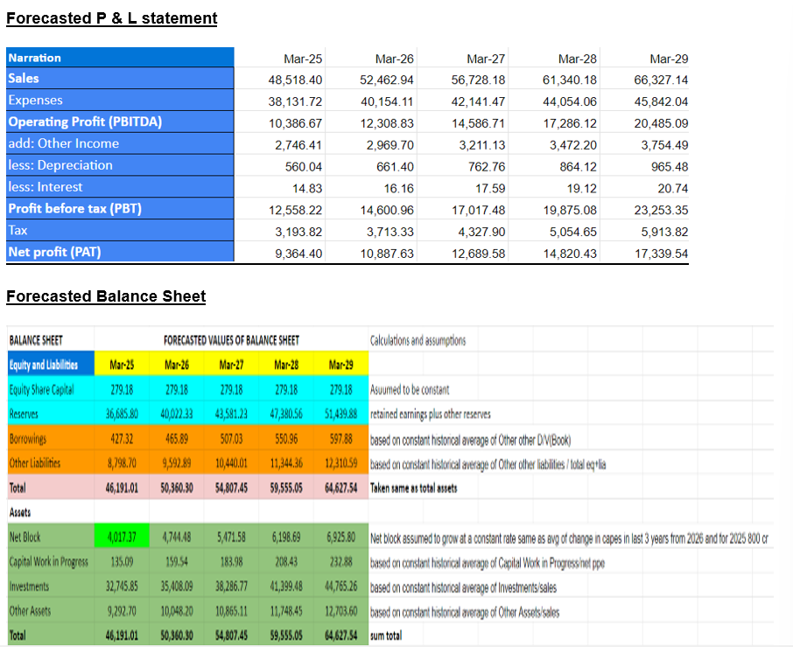
FORECASTED STATEMENTS

Slide 8
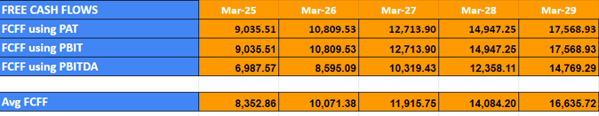
FREE CASH FLOWS TO FIRM
The FCFF use for all valuation purposes is :
Average of
FCFF from PBIT
FCFF from PAT
FCFF from PBITDA
FCFF growth rate (historical avg of last 8 years) = 11.85% used for DCF and other valuation purposes.

Slide 9
BETA CALCULATION
COST OF CAPITAL
Regression of NIFTY 50 1 year daily data with Bajaj Auto 1 year daily stock price data
Beta = 0.537
Regression of NIFTY 50 5 year monthly data with Bajaj Auto 5 year monthy data
Beta=1.073
Average Beta = 0.805
Assuming no change of capital structure in next 5 years, beta remains the same.
Since current market leverage is same as target market leverage for next 5 years D/V remains same.
WACC = (1-Tc)(D/V)(Kd)+(E/V)(Ke)
Cost of debt = Assumed to be same as Risk free Rate
(India 10 year govt bond yield = Rf=Kd=6.973%)
Cost of equity -> CAPM Model ->Based on Avg Beta
WACC = 16%
https://in.investing.com/rates-bonds/india-10-year-bond-yield-historical-data

Slide 10
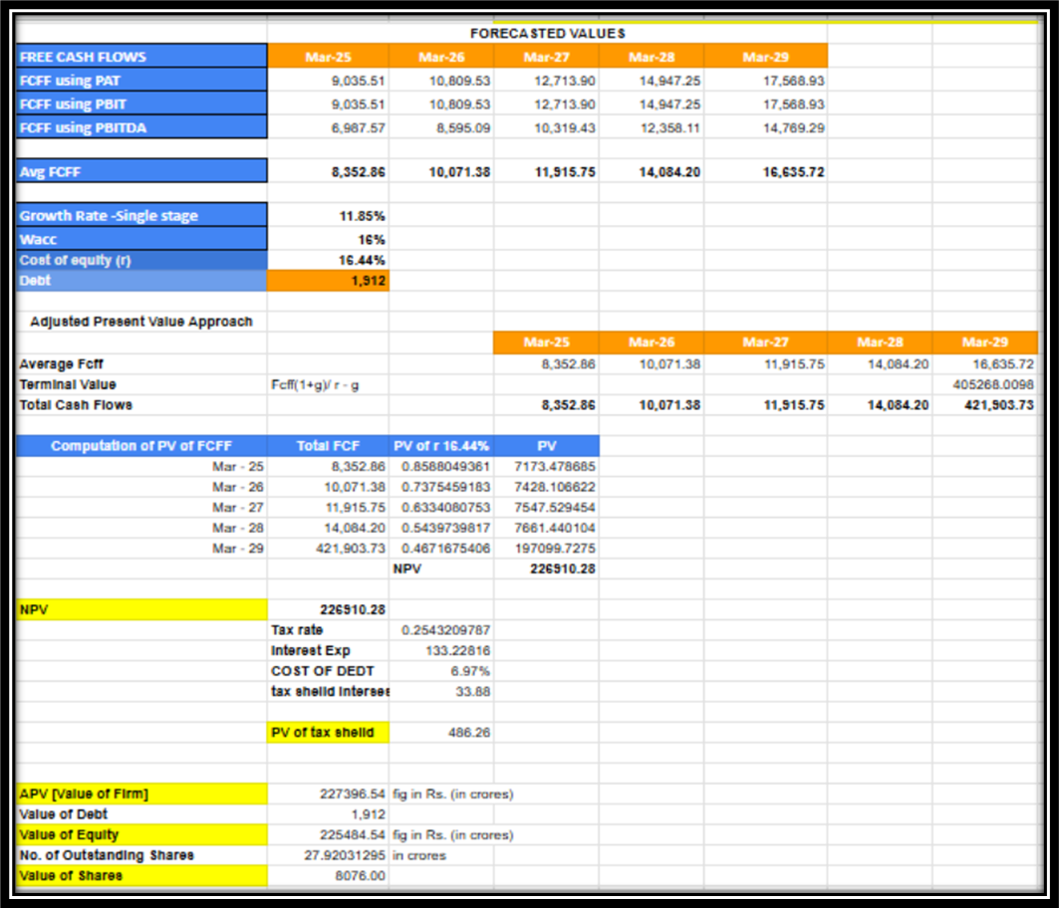
DCF VALUATION - APV APPROACH
Growth Rate – 11.85%
Cost of equity – 16.44%
Outstanding Shares - 27.92031295bn
Current Market Price – Rs 11374 per share
Intrinsic Value – Rs 8076 per share
Therefore shares are
OVERVALUED

Slide 11
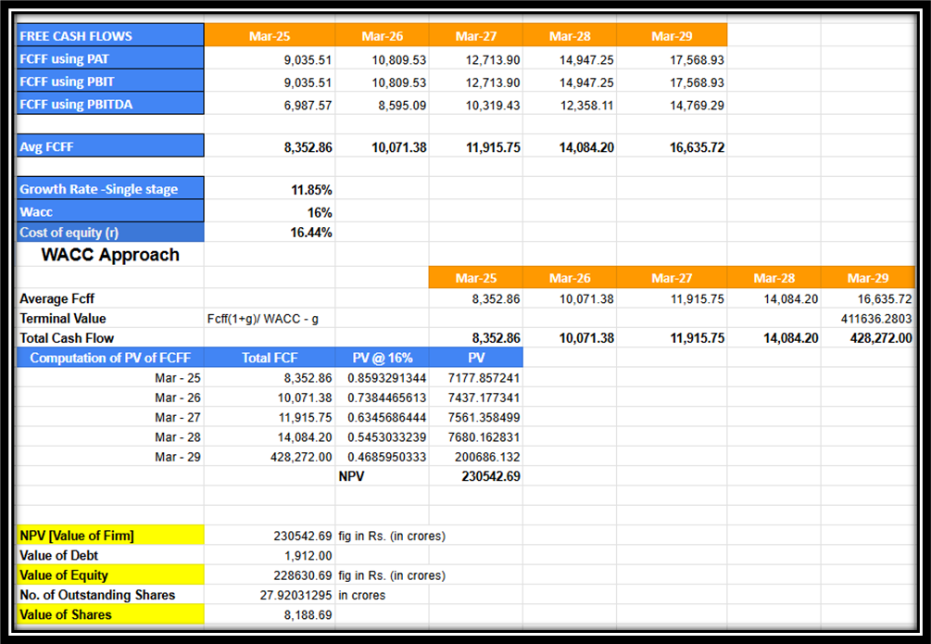
DCF VALUATION - WACC APPROACH
Growth Rate – 11.85%
WACC – 16%
Outstanding Shares - 27.92031295bn
Current Market Price – Rs 11374 per share
Intrinsic Value – Rs 8,188.69 per share
Therefore shares are
OVERVALUED

Slide 12
CAPITAL CASH FLOW APPROACH
The Capital Cash Flow (CCF) model values a business by discounting its total cash flows available to all capital providers—both debt and equity—over time.
This approach focuses on cash generated by operations, providing a clear view of the business’s financial health without the impact of financing decisions.
First, we calculate the total cash flows including the terminal value by discounting using WACC.
Then, we calculate the value of debt outstanding by taking the PV of the remaining cash flows at the end of each year.
We calculate the tax shield on interest using the debt outstanding.
Next, we calculate the Terminal Value using FCFF and pre-tax WACC as the discount rate.
Finally, we calculate the PV of FCFF including terminal value at the pre-tax WACC rate to arrive at the value of the firm.

Slide 13
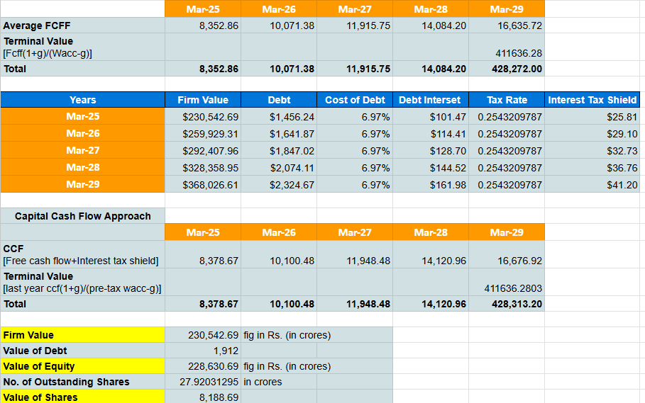
DCF VALUATION - CCF APPROACH
Growth Rate – 11.85%
Pre – Tax WACC – 16%
Outstanding Shares - 27.92031295bn
Current Market Price – Rs 11374 per share
Intrinsic Value – Rs 8188 per share
Therefore shares are
OVERVALUED

Slide 14
RESIDUAL INCOME MODEL
Residual income is the income a company generates after accounting for the cost of capital. ​
The residual income model attempts to adjust a firm's future earnings estimates to compensate for the equity cost and place a more accurate value on a firm.
Firstly, we forecast sales and operating incoming for five years using the expected growth rate.
We then calculate Net Financial Obligations (NFO) and Net Operating Assets (NOA).
We calculate the Residual Operating Income (ReOI) by deducting the product of the cost of capital and NOA from Operating Income.
Then we calculate the terminal value, after which we find the Present Value of both ReOI and Terminal value.
The value of the firm is calculated by taking the sum of NOA, PVReOI, and PVTV.
We calculate the value of Equity by subtracting Debt (NFO) from the value of the firm.

Slide 15
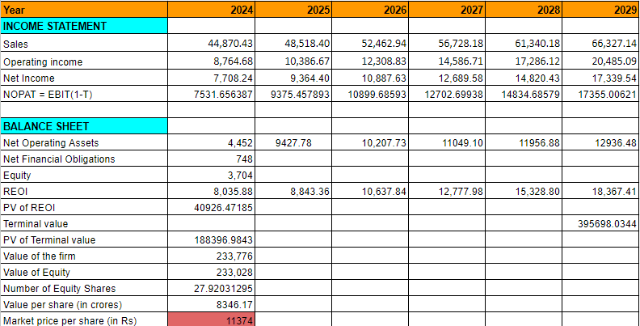
RESIDUAL INCOME MODEL
Growth Rate – 11.85%
WACC – 16%
Outstanding Shares - 27.92031295 bn
Current Market Price – 11374 rs per share
Intrinsic Value – 8346 rs per share
Therefore shares are
OVERVALUED

Slide 16
RELATIVE VALUATION MODEL
1. Choose Comparable Companies
Select firms with similar:
Industry, business models, growth prospects, risk profiles.
Financial structure (debt levels)
Bajaj Auto Comparables:
Highly Comparable:
TVS Motor Co. (2-wheelers, 3-wheelers).
Hero MotoCorp (2-wheelers).
Partially Comparable:
Eicher Motors (premium)
Atul Auto (3-wheeler)
2. Select Appropriate Multiples
EV/EBITDA:
For comparing core operational performance (e.g., TVS, Hero, Atul Auto).
EV/Sales:
For firms with inconsistent profitability but steady revenue (e.g., Atul Auto).
P/E Ratio:
For mature, consistently profitable companies (e.g., Hero, TVS).
3. Calculate Multiples for Comparables
Gather data from:
Financial statements or reliable financial sources.
Multiples to calculate:
P/E, EV/EBITDA, EV/Sales for each comparable company.

Slide 17
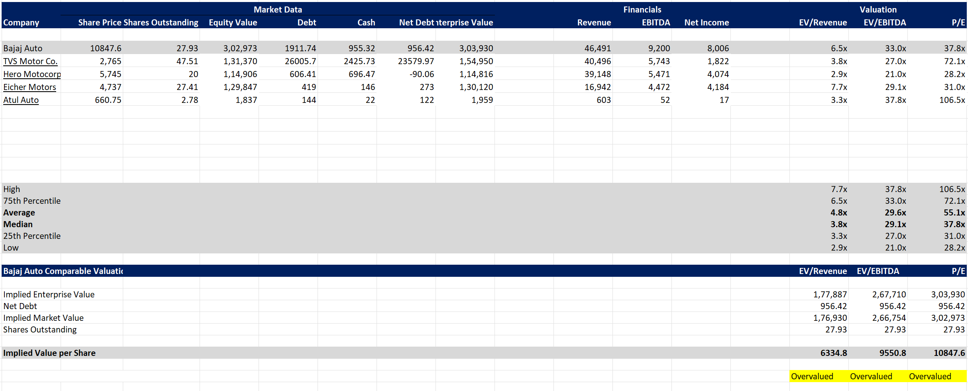
RELATIVE VALUATION MODEL
Implied EV = Net Debt + Implied Market Value of Equity
Share Price > Implied Market Value per share = Overvalued

Slide 18
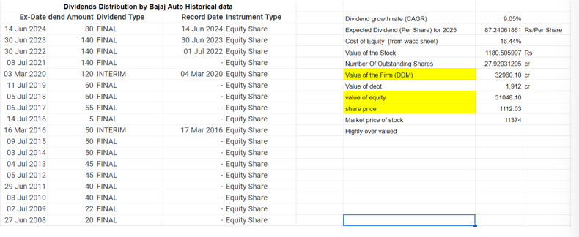
DIVIDEND DISCOUNT MODEL

Slide 19
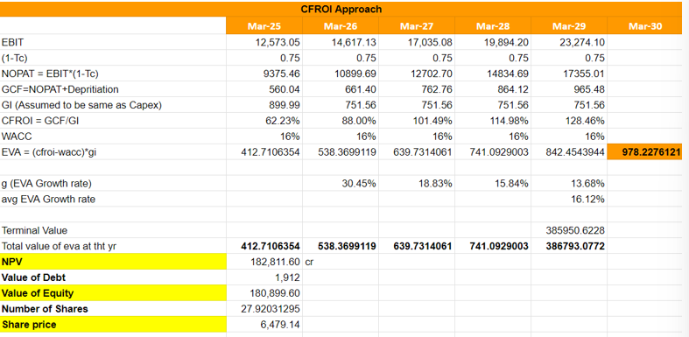
CFROI APPROACH

Slide 20
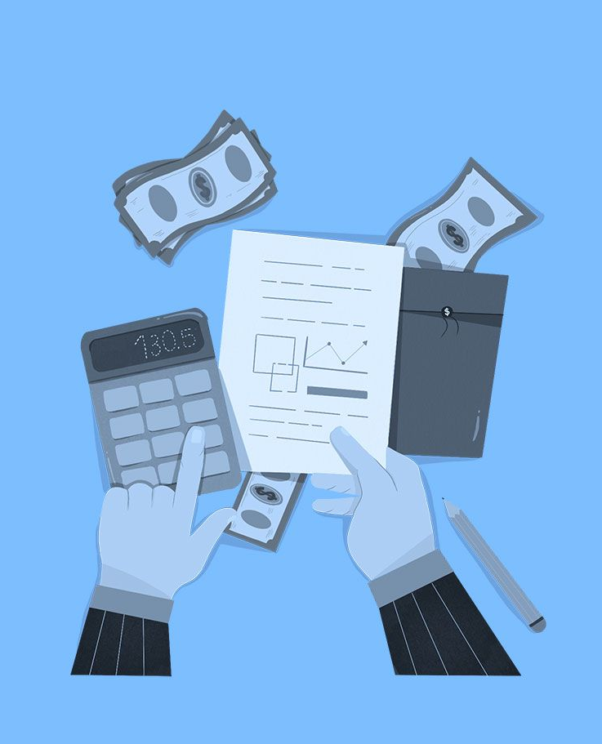
ECONOMIC VALUE ADDED
In 1989, the New York firm of consultants, Stern Stewart & Co. patented and launched EVA, a variation or modification of what was previously called "residual income or profit". That is the result obtained by subtracting the capital costs from the operating profit. Thus, EVA is the value that remains in a business once the latter has successfully paid off all its expenses with the minimum profitability estimate required.
It is used as a financial performance method to calculate the actual economic profit a company earns.
EVA arose to cover the gaps and solve the limitations of the traditional economic indicators.
The added economic value is used to determine the business objectives, measure the performance of the company and know the costs incurred.
EVA is much more than an economic indicator, it reflects a business management focused on value.
EVA allows investors and shareholders to evaluate the performance of the company and the risk level that an investment may pose.

Slide 21
ECONOMIC VALUE ADDED
Firm Value = Invested Capital + PV of Future EVAs + PV of Terminal Value
NOPAT = Operating Profit (EBIT) - Taxes
Invested Capital = Debt + Shareholder's Equity
Weighted Average Cost of Capital (WACC) = 16%
Economic Value Added (EVA) = NOPAT - (Invested Capital * WACC)
Estimate the Company's EVA for the next five years
PV(EVA) = EVA/(1+WACC)^t
Terminal Value = EVA/(WACC-g)
STEP 1
STEP 2
STEP 3
STEP 4
STEP 5
STEP 6
STEP 7
STEP 8

Slide 22
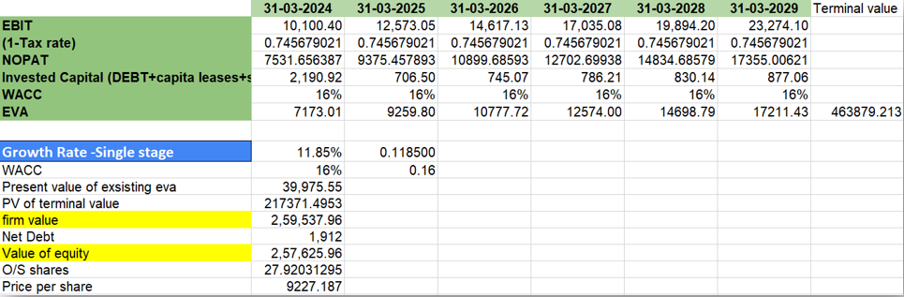
ECONOMIC VALUE ADDED
Current Market Price – 11374 rs per share​
​
Intrinsic Value – 9227 rs per share​
​
Therefore shares are​ OVERVALUED

Slide 23
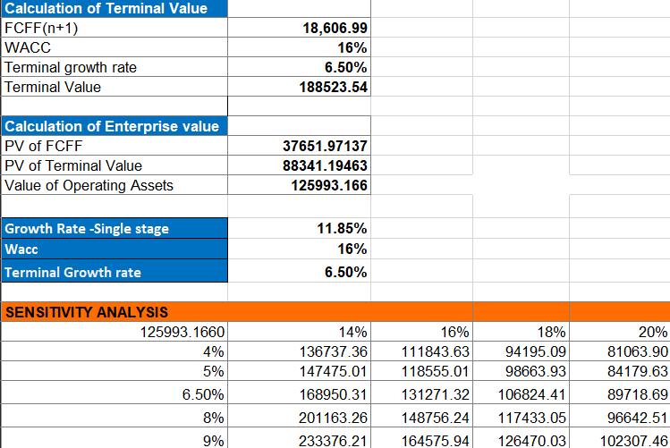
SENSITIVITY ANALYSIS
The sensitivity analysis provides insight into the enterprise value of Baja Auto under various assumptions for terminal growth rates and WACC.
Lower WACC results in higher enterprise value: As WACC decreases, the enterprise value increases.
Higher growth rates increase the enterprise value: Similarly, as the growth rate increases, the value increases for any given WACC.
For Baja Auto, the sensitivity analysis suggests that if the company can maintain or achieve higher growth rates, the enterprise value will significantly increase, especially if the WACC can be reduced or kept low.
The worst-case scenario (20% WACC and 4% growth) results in a much lower value of 81,063.90, compared to the best-case scenario (14% WACC and 9% growth) with a value of 233,376.21.

Slide 24
CONCLUSION
Model | Intrinsic Value | Market Value
APV Model | 8,076 | 11,374
WACC Model | 8,188.69 | 11,374
CCF | 8,188 | 11,374
Residual Income | 8,346 | 11,374
Relative Valuation | 10,847 | 11,374
DDM | 1,112.03 | 11,374
CFROI | 6,479.14 | 11,374
EVA | 9,227 | 11,374
Average | 7,577 | 11,374

Slide 25
CONCLUSION
All the models of valuation suggest that the given stock of Bajaj Auto is overvalued.
Where models like DDM suggest a high overvaluation others differ in the extent but the conclusion remains the same.
We have tried to remain conservative while choosing assumptions by removing positive outliers to show the worst case picture of the firm value
We can hence say investors can buy the stock upon thorough research and lot of caution is necessary.

